Slide 1
spice models for Nand flash memory Cell
By
Devesh Kumar

Slide 2
Paper Reviewed
A Behavioral Compact Model of 3D NAND Flash Memory. Author: Shubham Sahay and Dmitri Strukov
Modeling NAND Flash Memories for IC Design Author: L. Larcher, A. Padovani, P. Pavan P. Fantini, A. Calderoni, A. Mauri, and A. Benvenuti
Notes:
I HAVE REVIEWED TWO PAPERS ON CIRCUIT MODELS FOR 3D NAND FLASH MEMORY

Slide 3
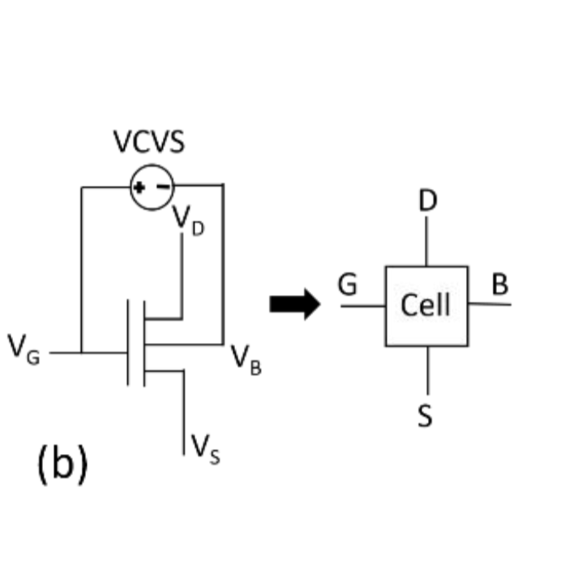
A Behavioral Compact Model of 3D NAND Flash Memory
In the first paper they have models each individual memory cell as shown. They have added the substrate bias to mimic the Vt shift in Program and erase.
In this paper they have taken 3×3 string array of vertical channel charge-trap (CT) devices with a gate stack of oxide/nitride/oxide (O/N/O) and Macaroni body
Ref : A Behavioral Compact Model of 3D NAND Flash Memory by Shubham Sahay, Dmitri Strukov

Slide 4
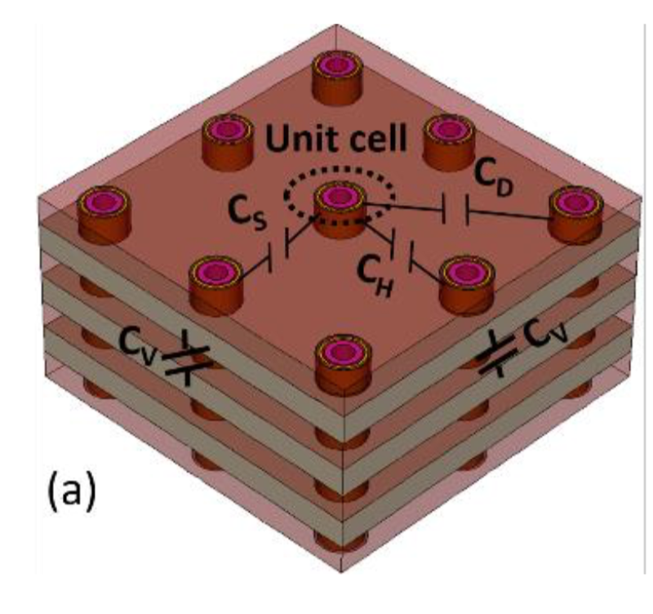
CH : The cell-cell coupling between adjacent cells sharing the same WL
Cv : the vertical coupling between the cells on the same string is taken into account via a vertical capacitance
CD: the coupling between diagonal cells and the neighboring cells is considered using CD the diagonal capacitance and the side capacitance Cs
Ref : A Behavioral Compact Model of 3D NAND Flash Memory by Shubham Sahay, Dmitri Strukov
Notes:
In the first paper A Behavioral Compact Model of 3D NAND they have simply approximated each memory cell as in the array as figure 1. in this they have added the bias voltage VCVS to mimic the chane in Vt that occures during program and erase.

Slide 5
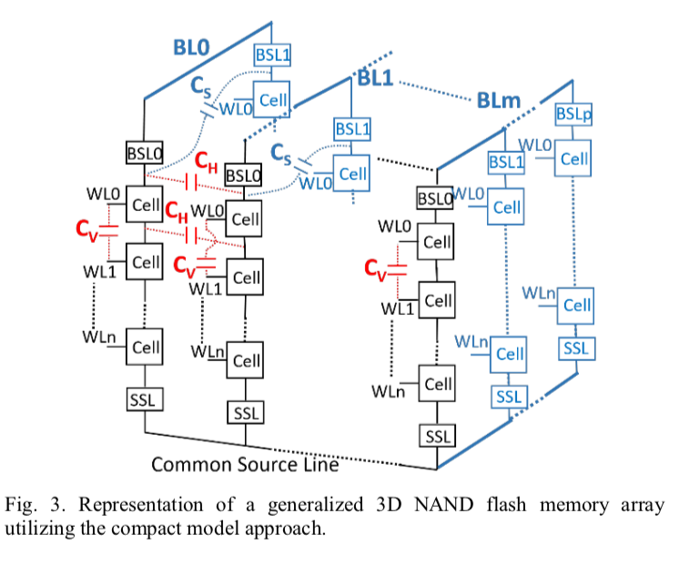
Here to model every string we need eight other strings
To calculate the coupling capacitance (CV, CH, CS and CD) they have used mixed-mode Tcad simulations. For the basic mos the BSIM-CMG 110.0.0 compact model was used by them
They have done simulation on 10 WLs
Ref : A Behavioral Compact Model of 3D NAND Flash Memory by Shubham Sahay, Dmitri Strukov

Slide 6
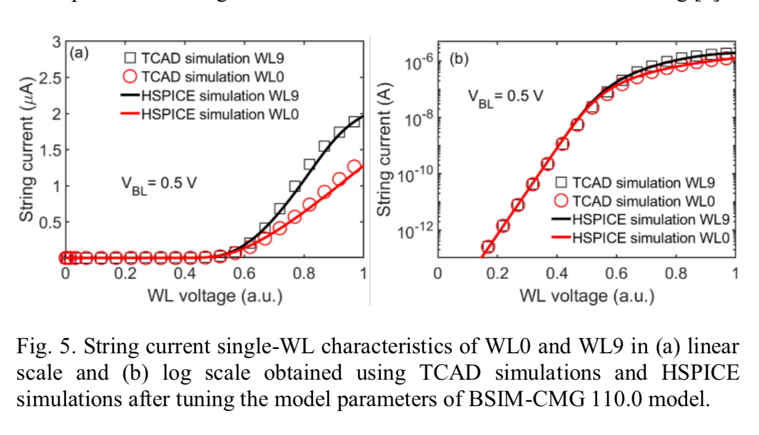
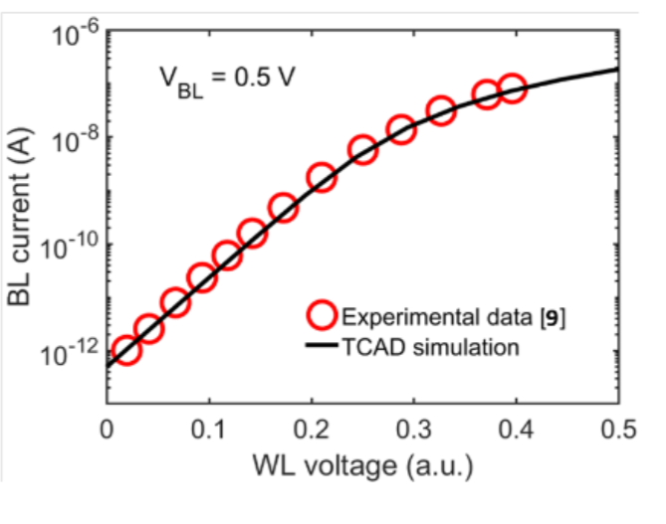
Ref : A Behavioral Compact Model of 3D NAND Flash Memory by Shubham Sahay, Dmitri Strukov

Slide 7
Modeling NAND Flash Memories for IC Design
In this paper they have considered three nand string to model the middle string
They have used Two coupling capacitances to model coupling in X and Y direction.
They have used a different model for unit cell . In their model they represent the floating gate as an capacitor. They have introduce I p/e which represent the current that occurs due to tunneling during program and erase

Slide 8
